Slide 1


Transforming how the world builds software
Yadhav Jayaraman
Platform Architect
@yadhavj
yjayaraman@pivotal.io

Slide 2
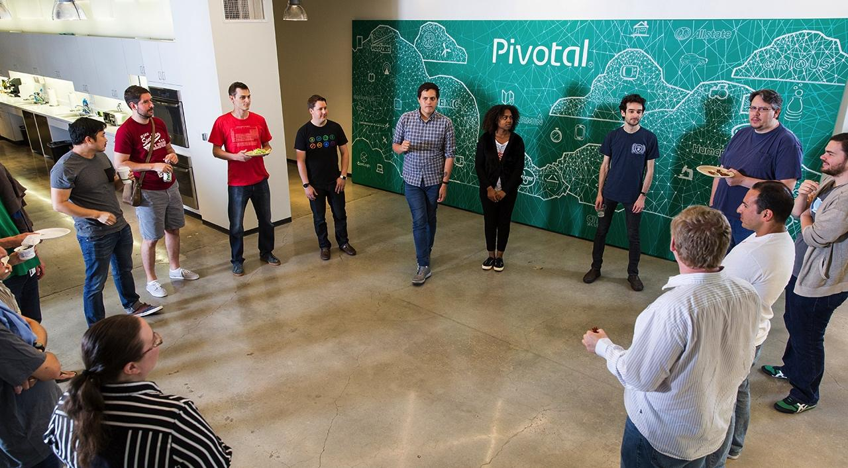

Our mission is to transform how the world builds software
Notes:
Our mission is to transform how the world builds software.
A few years ago, Rob Mee (CEO of Pivotal) created that mission when Pivotal Labs was working to shape the software development cultures of Internet giants such as Google, Twitter, eBay, etc. At the time, since Pivotal was so small, it felt aspirational.
Now, at scale, we have over 2,500 employees across 20 worldwide office locations—so when you help the world’s largest companies couple software proficiency and 100 years of industry-specific experience, then it starts to feel like we are transforming how the world build software [in partnership with our customers].

Slide 3

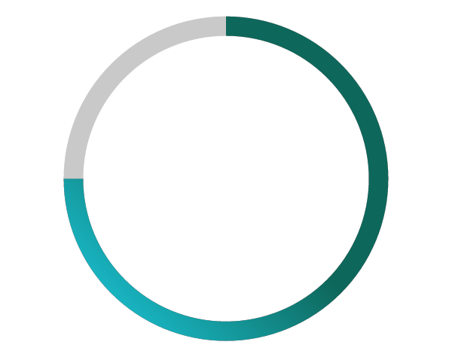
75%
of application development supporting digital business will be built not bought by 2020
Source: Gartner
Notes:
One of the most interesting things about software development, increasing use of open source, and increasing use of SaaS-type solutions, an assumption many people might make is that the need to create custom software for an enterprise will diminish over time.
But, it turns out that’s not really true… it’s not the trend.
Gartner did a report, and their analysis showed that by 2020, 75% of application development will be built… not bought. In other words, it will be custom built.
This supports our belief that enterprises need to become software development companies themselves. Because the areas of their business that they need to focus on in order to differentiate themselves from their competition will increasingly be in software. They’ll be building these software applications themselves, or with a partner like Pivotal.

Slide 4





Key Trends
The cost and ubiquity of computing enables cloud native software companies to reshape the world
Mobile devices and connectivity
Near-free computing costs
Global scale of operations
Ubiquity of embedded sensors
Notes:
Software (and software-based companies) are reprogramming the world—as Steve Jobs famously suggested about new Apple products, “... changes everything.”
What makes this possible is the infinite amount of inexpensive computing and storage power now available to us. A lot of the ubiquity and intelligence of computing is driven by the fact that you can throw computing power and storage resources at the problem in a way that you simply could not do before. If you look at the disruptive companies in the world today, this is exactly what they're doing—and well. They are taking lots of information, analyzing it in real-time, adding intelligence and using modern techniques to reshape industries and construct new business models.

Slide 5

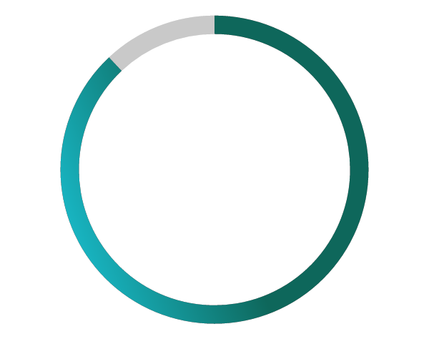
88%
of Fortune 100 companies no longer exist (1955 vs. 2014)
Source: American Enterprise Institute (2014)
Notes:
As a result, only 12% of the Fortune 500 companies in 1955 are still on the list 59 years later in 2014—almost 88% of the companies from 1955 have either gone bankrupt, merged, or still exist but have fallen off the Fortune 500 rankings.
Even worse, most of the former industry titans on the 1955 list are now unrecognizable—forgotten companies today such as Armstrong Rubber, Cone Mills, Hines Lumber, Pacific Vegetable Oil, and Riegel Textile.

Slide 6


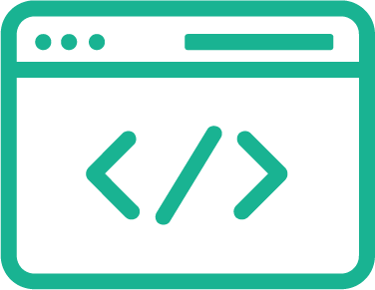
Developer
Increase Feature Velocity
Decrease Spend
Operator
Increase Service Levels
Decrease Cost
Notes:
Now that we established that you have the right people in your organization, let’s talk about the unproductive environments and impossible constraints that hold them back.
IT services two stakeholders—Leader of a Business and the CFO.
The Business Leader sees trends and market opportunities such as a connected car or IoT, and asks IT to prototype solutions in 6 weeks opposed to 6 months. But, there’s no new funding to build software.
Similarly, the CFO is looking to deliver greater profitability to shareholders, and asks IT to rip out cost in the tens and hundreds of millions. But, there IT has to continue maintaining or improving service levels to support the business.
It’s the dilemma every CEO, CTO, and CIO have been struggling with for over a decade—how to fund the future without hurting the present.

Slide 7
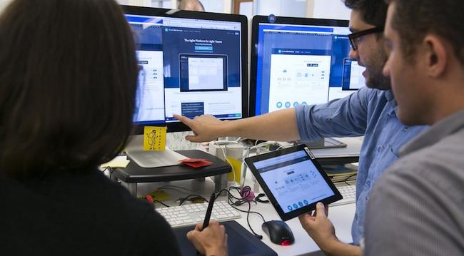
TRANSFORMING INTO A MODERN SOFTWARE COMPANY
Building high-quality software at start-up speed requires modern software methodologies, cloud platform, and data tools
01
02
03
Modern Cloud Native Platform
Modern Software Methodology
Modern Data Tools
Notes:
Businesses really face two very big challenges. How do they acquire the technical capability? How they transform the culture of the organization, to realize the full potential of these capabilities.
When we talk about becoming a software company, and operating at startup speeds, there’s a couple of things that are needed—a modern cloud platform, modern approach to software development, and very powerful data tools that are integrated with your software.
One of the primary differences between enterprises and software companies like Google, Facebook or Uber is that the first two—modern cloud platform and modern software methodology—have been taken for granted by software companies for a number of years. When an Uber developer needs more capacity, he or she doesn’t file a ticket with an IT department and ask for a new server. That’s not the way it works. That developer has access to modern cloud technology at their fingertips. And in terms of a modern software development methodology, Pivotal has been working with many of Silicon Valley’s most iconic and admired companies for years. We can attest that they don’t working in the very rapid pedal to the metal way that Pivotal does. But, they work in a slightly less intense version of that… that assumes change is continuous, and they’ll change their software continuously to accommodate. And that alone is the fundamental difference in how software has been done traditionally, and still done in a majority of large companies around the world.
At a minimum, if you don’t have a modern cloud platform and modern software methodology used by software companies—when you’re disrupted, then you don’t have the ability to respond. Moreover, you also cannot even begin to think about becoming a disruptor yourself.
Then for the sophisticated, the use of modern data tools allows companies like Google, Facebook, and Uber to gather feedback from their customers to improve their experience. Moreover, it also gives them access to data that allows them to continuously experiment on ideas to break into new markets.

Slide 8
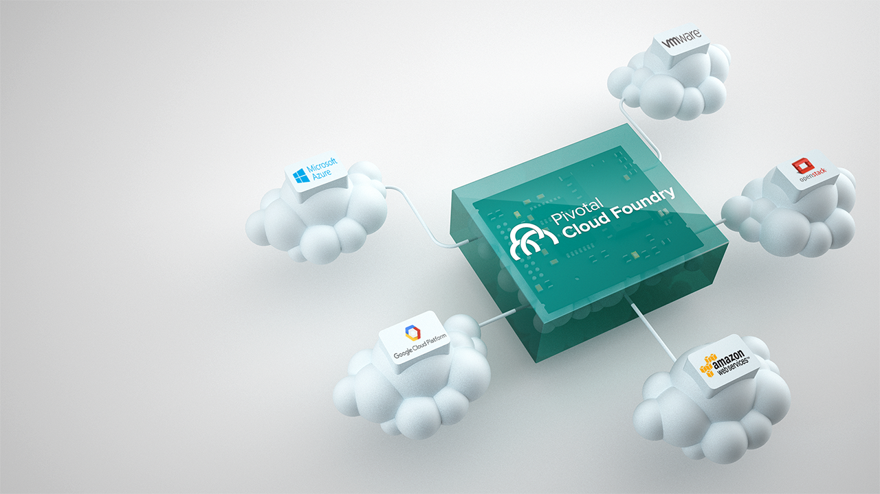
01
Modern Cloud-Native Platform
Building high-quality software at start-up speed requires modern software methodologies, cloud platform, and data tools
Notes:
Focus on the part of the stack that drives the most value for the company.
Enterprise organizations that focus on building a custom IT stack do not have the resources and time to build great user-experiences for their customers. It feels great to build a custom stack, but it’s not good for the company. If you’re going to build something… then build software that engages your customer.
Now we are moving away from traditional hardware to the new hardware: cloud oriented, scaled out hardware. What we're offering is a simple way to get all of the software you need in one place, to basically build up modern applications, not only exploiting that modern hardware, but doing it in a fundamentally portable way so that when you make a commitment to write one of these applications, you're not locking yourself into an underlying infrastructure vendor for all eternity.
There are a lot of opportunities, a lot of choices of where to run application workloads these days. It can be run in a private cloud, in your data center, in a public cloud, Google or Amazon, a combination, but all of these different locations at the moment require companies to develop, deploy and operate their software applications differently. If they are trying to get some kind of commonality across these different platforms, they must do a lot of work themselves to build that. Now that work is not directly related to their industry expertise. It's not directly related to the expertise that they've built up over many years. That is purely software infrastructure development and my message here is they don't need to do that.
Pivotal has spent a lot of time with a lot of engineers and a lot of money to build a platform that allows companies to run software applications the same way on top of any underlying infrastructure, whether it's behind the firewall, in a data center, whether it's on a public cloud, it's all the same. This is called Pivotal Cloud Foundry.

Slide 9


01
The Home Depot has over 3,000 application instances—core to running their $83 billion dollar business—running on Pivotal Cloud Foundry.

Slide 10


01
Comcast can now convert an idea into a feature in 2-3 days [not months]... and has over 900 developers innovating every day on Pivotal Cloud Foundry.

Slide 11

02
Modern Software Methodologies
A modern platform requires a modern approach to software development
Agile Software
Methodologies
Lean Startup
Techniques
Optimized for
Change
MODERN SOFTWARE
METHODOLOGY
MODERN SOFTWARE
METHODOLOGY
MODERN SOFTWARE
METHODOLOGY
Building a strategy for product development
Building a quality product at startup speed
An organization optimized
to respond to disruption
Notes:
How do you build software like Google, Uber, or a venture-backed startup?
The modern software methodology combines Agile Software techniques that have been continuously evolving over two decades, Lean Startup techniques which is a recent movement that’s being honed in Silicon Valley, and then putting together to create a software methodology that’s optimized for change.

Slide 12


02
Allstate created CompoZed Labs—based on Pivotal Labs—to operate like a startup, and put an idea in front of a customer in a week [opposed to a year].

Slide 13


03
Daimler’s connected car application [Mercedes me] is built on top of Pivotal technology, and gives drivers real-time information about the status of their cars through their smartphones and smartwatches.

Slide 14


03
General Electric’s industrial IoT platform [GE Predix] is built on top of Pivotal technology, and is transforming GE into a software and analytics company.

Slide 15

Modern Cloud-Native Enterprise
Building high-quality software at start-up speed requires modern software methodologies, cloud platform, and data tools
Notes:
This is the modern technology stack to help your enterprise increase developer productivity and operations efficiency.

Slide 16
What Raytheon Wants To Achieve
Provide modern application platform service to business units
Drive DevOps efficiencies, culture change through self-service & hyper-automation
Embrace new cloud native patterns and constructs to speed business innovation
Reduce ongoing operations costs and complexity
Improve application security, resiliency, elasticity, manageability, speed of patching
Support cloud choice and portability (vSphere, OpenStack, Azure, AWS, Google, etc)

Slide 17
What’s Important to Raytheon’s Desired Outcomes
GBS – Speed, Stability, Security as goals for PCF pilot
GBS - Kerry Finn - "A platform that supports continuous everything DevOps is a key theme of Raytheon's end to end SDLC value stream enablement that helps us move from a variety of SDLC methodologies (e.g. RAD, iterative, waterfall) towards one common agile business outcome based (e.g. "Deliver Mission/Business solutions with critical capabilities, 50% cheaper, 50% faster with 100% show stopper and critical defects resolved") approach .”
IIS – iRAD, cRAD projects with Pivotal as a Partner. Pathfinder program for Air Force in Boston Labs. DCGS and DOMino programs as potential opportunities to pair with Pivotal.
IIS – DCGS, DoMiRMS – Matt Kehret - move from current (25-30) IT Ticket based app deployment process, reduce or eliminate the IBM middleware management outsourcing service

Slide 18
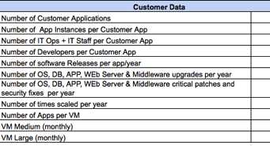

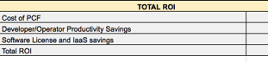
Expected outcome for Raytheon
Developer and IT Operation Productivity
Average Developer is able to Provision and Install 50% faster
Average IT Operator can Configure, Deploy, Monitor and Scale App Lifecycle 90% faster.
Support multiple development languages
Software License Savings
Based on Open Source platform and designed to avoid vendor lock-in
Single platform removes the need for complex, multi-vendor contracts
Future-Proof your IT environment
Infrastructure Utilization
App-centric instead of infra-centric approach
Higher packing density equals better workload utilization
Spend time optimizing for business needs, instead of configuration management

Slide 19
Appendix

Slide 20
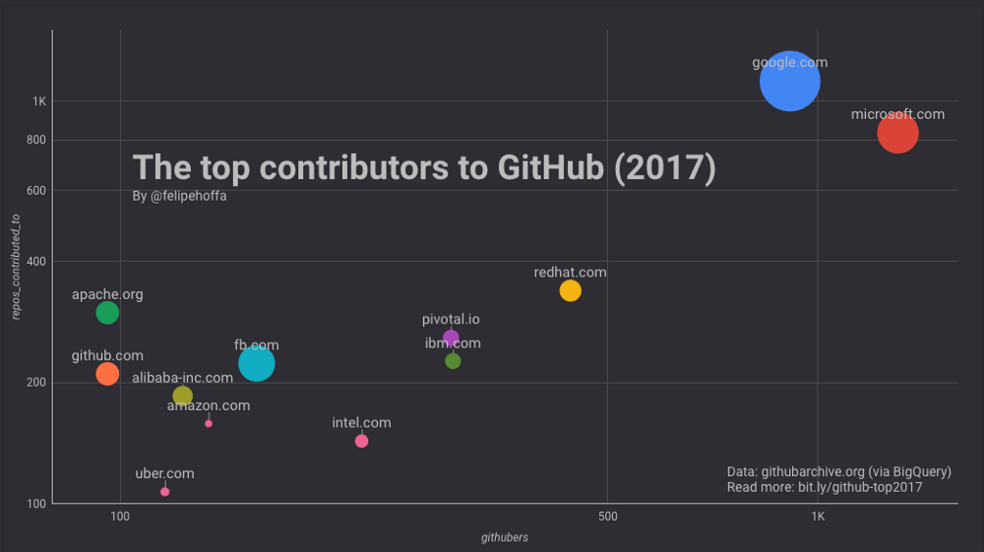
Pivotal among the top contributors to Github
Notes:
https://redmonk.com/jgovernor/2017/10/25/some-thoughts-on-the-top-contributors-to-github-2017/
Felipe Hoffa from the Google Dev Rel team published some interesting research looking at corporate usage of GitHub. Microsoft appears to have ~1,300 employees actively pushing code to 825 top repositories on GitHub.
Google displays ~900 employees active on GitHub, who are pushing code to ~1,100 top repositories.
Amazon appears to have only 134 active employees on GitHub, pushing code to only 158 top projects.
So all the usual caveats on using GitHub data notwithstanding, and the limits of this particular analysis, Microsoft has the most contributors by some distance, some 45% more than than Google, but they’re working on a smaller number of top projects. Amazon Web Services meanwhile barely shows up as a contributor. Nothing really surprising in any of this, except, Pivotal is currently contributing as much software to open source projects as IBM. Given IBM has built deservedly solid reputation over time as an open source contributor across various core infrastructure projects, and is at least 150 times bigger than Pivotal, this is fairly impressive

